Slide 1
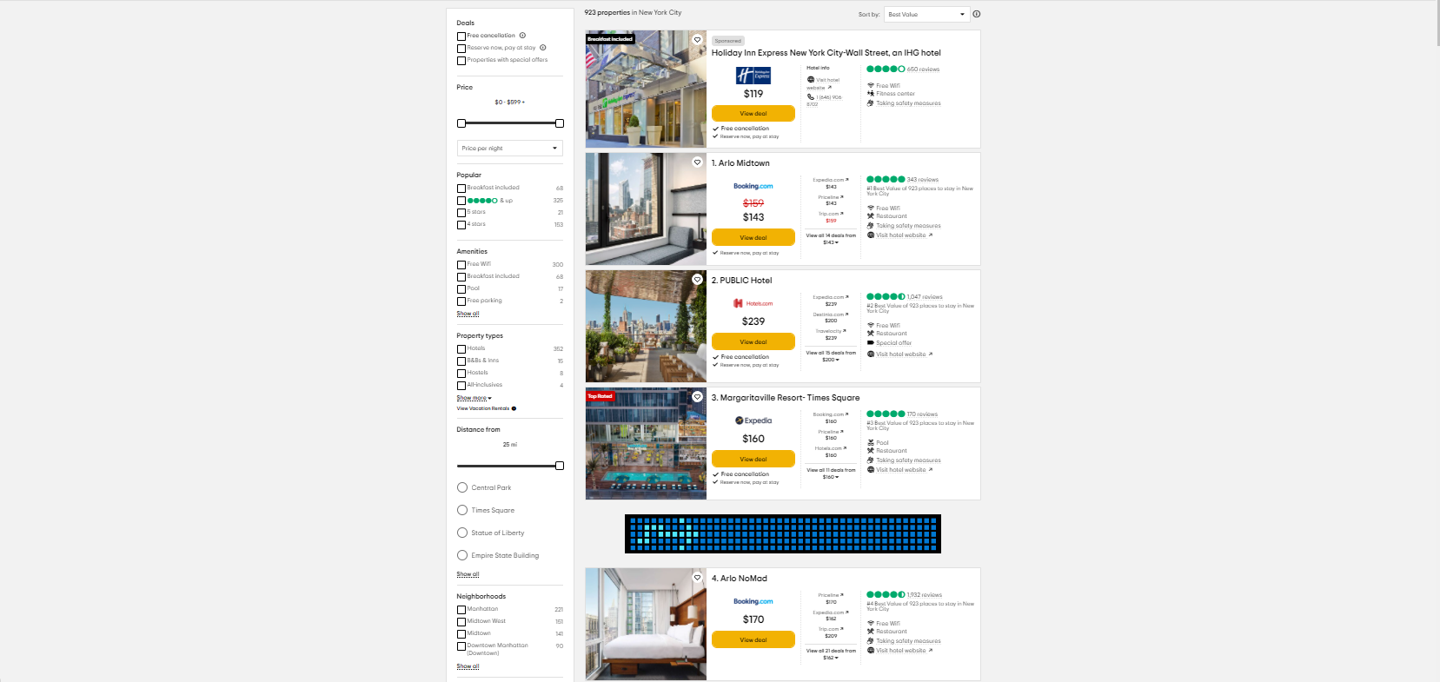
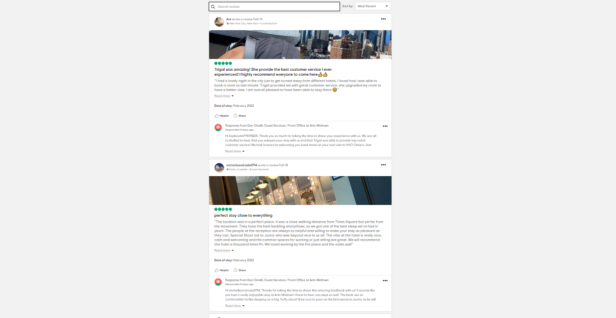
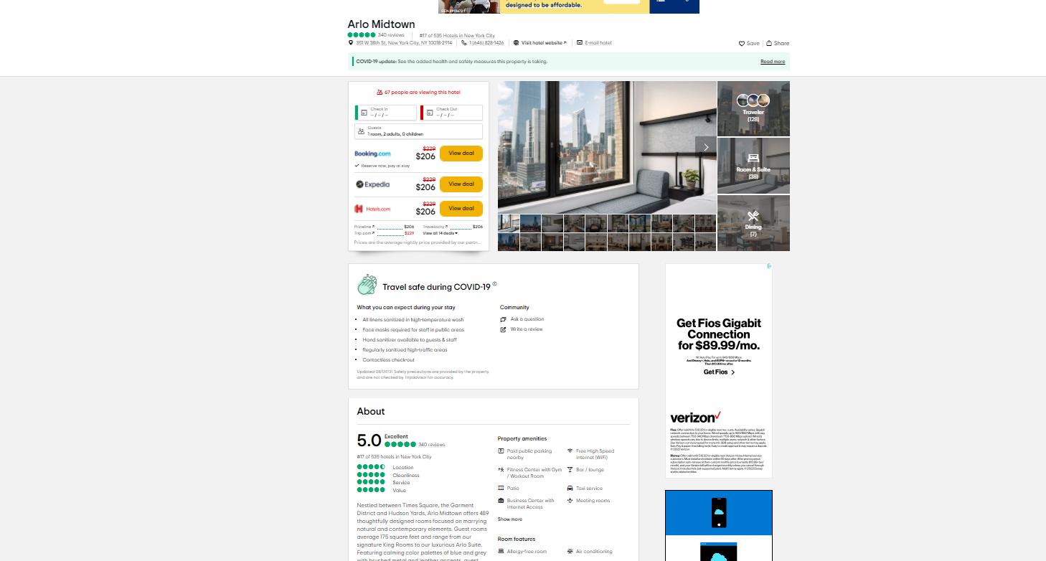
Scrapping_1 – Download list of sites
City
New York
Los Angeles
Miami
Detroit
Dallas
Chicago
Seattle
…
Category
Hotels
Restaurants
./DATA/TA_city_i _category_i.rds
site_id (PK)
name
City
Category
url
…
List of site URL’s downloaded
For every city/cat
url 1
url 2
url 3
url i
For every site url
Html data
Scrapping_2 – Download review pages
./HTML/review_page_id.html
Info by site
Review page 4
./SAVE/site_url_i.rds
site_id (PK)
Review_page_id (PK)
Html_id (FK)
Html_location
Download_date
…
Review page 3
Scrapping_3 – Download Images
Review page 2
Review page 1
./SAVE2/site_url_i_meta.rds
Site_id (PK)
Review_page_id (PK)
About_info (table)
Review_info (table)
Image_info (table)
Html meta data
Images
./IMG/image_ij.jpeg

